Slide 1


AI PREDICTIVE MODEL
FOR CREDIT
UNDERWRITING

Slide 2
SYNOPSIS
Objective: Develop an AI-Predictive Model for
underwriting system to enhance loan approval predictions.
credit
Data Collection & Preprocessing: Handle missing values, feature encoding,outlier removal, normalization.
Results & Impact: GBC improves accuracy, risk assessment, and decision-making, reducing false approvals and rejections.
Outcome: A Streamlit-based AI app for loan predictions, EMI calculations, AI-driven financial advice, and report generation.

Slide 3
AI PREDICTIVE CREDIT UNDERWRITING VS. TRADITIONAL CREDIT UNDERWRITING
AI Predictive Credit Underwriting
Automated & Data-Driven
Advanced Risk Analysis Reduced Bias
Self-Learning Models
Traditional Credit Underwriting
Manual & Rule-Based
Limited Data Usage Higher Risk of Bias Fixed Risk Assessment

Slide 4
ML MODELS
Logistic Regression
Decision Tree
Random Forest AdaBoost
Naive Bayes
Gradient Boosting

Slide 5
TESTING AND EVALUATION
Comparison of Machine Learning Models

Slide 6
GRADIENT BOOSTING
WHY GRADIENT BOOSTING IS THE BEST CHOICE?
RESULTS &
PERFORMANCE METRICS
Higher Accuracy & Performance Handles Complex Relationships Feature Importance
Accuracy: 98.78%
Precision : 98.90% (Class 0) , 98.65% (Class 1)
Recall : 98.71% (Class 0) , 98.84% (Class 1)
F1-Score : 98.80% (Class 0) , 98.75% (Class 1)
Confusion Matrix:
[ [ 537, 7 ] , [6, 513 ] ]

Slide 7




LIBRARIES
Programming Language: Python
Streamlit FPDF
pandas matplotlib joblib transformers langdetect

Slide 8
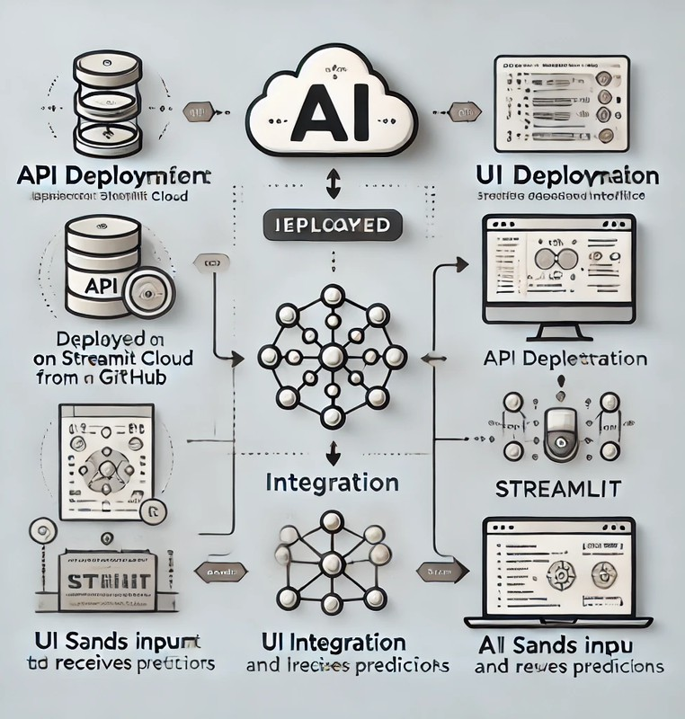
IMPLEMENTATION DEPLOYMENT
API Deployment
UI Deployment
Integration
Testing

Slide 9
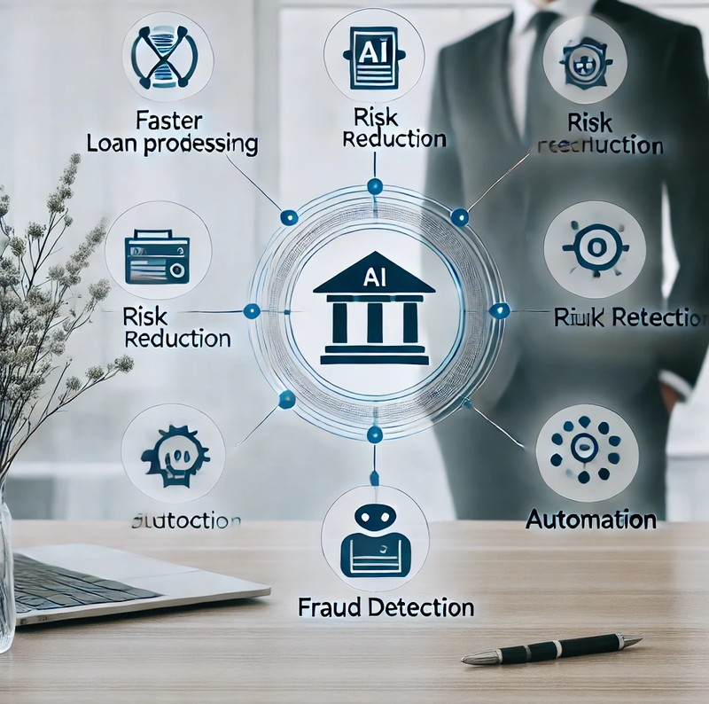
BENEFITS OF MODEL
🚀 Faster Loan Processing
📊 Data-Driven Decision Making
💰 Reduced Risk of Loan Defaults
🎯 High Accuracy in Predictions
📉 Lower Operational Costs
👥Fair & Transparent Credit Scoring

Slide 10

⏳ Time-Consuming Process
CHALLENGES IN TRADITIONAL CREDIT UNDERWRITING
👥 Human Bias & Subjectivity
📄 Limited Data Utilization
💸 High Operational Costs
⚠ Higher Risk of Loan Defaults
📉 Inconsistent Decision-Making

Slide 11
Faster Loan Approvals
BUSINESS PROPOSITION & TARGET CUSTOMERS
Lower Default Risks
Cost Efficiency
NBFCs (Non-Banking Financial Companies)
Fintech Companies

Slide 12
CASE STUDY
Background:
A leading NBFC faced challenges in loan approval delays, high
default rates, and biased decision-making do to manual underwriting.
Problem Statement
Lengthy loan approvals (7–10 days).
High default rates due to poor risk assessment.
Manual underwriting caused bias & inconsistency in approvals. Limited scalability to process high loan application volumes.

Slide 13
CONCLUSION
After evaluating multiple models, Decision Tree, Random
Forest, and Gradient boosting achieved over 99% accuracy, proving their robustness.
Logistic Regression performed poorly, highlighting its limitations in complex credit risk patterns.
The final model was deployed using Streamlit for an interactive and user-friendly experience.

Slide 14



ACKNOWLEDGEMENT
We sincerely thank Mr. Vivek Gautam sir for his invaluable guidance and support
throughout this internship.
We also extend our gratitude to Infosys Springboard for
providing this amazing opportunity to apply our
academic knowledge to real- world challenges.
Through this project, we
gained hands-on experience in: Machine Learning,Model
Development, and UI Development.

Slide 15



Online Resources:
Scikit-learn Documentation: scikit-learn.org
Pandas Documentation:
pandas.pydata.org Kaggle: kaggle.com.
Articles & Learning Materials:
"A Comprehensive Guide to Regression in Machine Learning"
Streamlit Documentation:
https://streamlit.io
Tools for Development & Deployment:
YouTube Tutorials (YT)
Google Search & Google Colab (AI & ML Experiments)
VS Code (Code Editing & Debugging)
REFERENCES & ONLINE
RESOURCES

Slide 16
THANK YOU!

